Slide 1
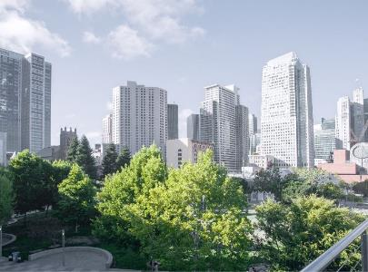
An Overview of Sustainable Concrete Design
Dr. Andrea Schokker, P.E., LEED AP
10.18.2022
www.neuconcrete.org

Slide 2

Presentation Notes
Find presentation slides and post-event recording at:
  https://www.neuconcrete.org/events-and-education
Attendees are in listen only mode.
Ask questions via the Q&A dialog box in zoom platform

Slide 3
Presentation Overview
Green concrete, carbon neutral concrete, sustainable design… so many terms and so much to learn about how to make it happen.
Join Andrea Schokker, NEU Technical Consultant and Board Advisor, to get an overview of sustainable concrete basics from material choice to design. We’ll also explore what to do now and what we expect for the future.

Slide 4

Today’s Speaker
Andrea Schokker
Andrea Schokker is the Senior Technical Consultant and Advisor to the Board for NEU. She is also on the Engineering staff with ACI.
Prior to joining ACI, she spent 14 years as a Professor at the University of Minnesota Duluth and ten years on the faculty at Penn State. She holds a PhD in Structural Engineering, is a licensed Professional Engineer in Minnesota and is a LEED Accredited Professional. She has authored two books on Sustainable Concrete and was the founding chair of ACI committee 130 on Sustainable Concrete.

Slide 5
An Overview of Sustainable Concrete Design
Dr. Andrea Schokker, P.E., LEED AP
10.18.2022
www.neuconcrete.org

Slide 6

Overview
The lingo
Carbon emissions
Life-cycle
Overview of sustainable concrete
What to expect next

Slide 7
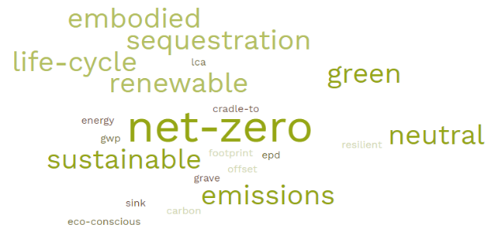

The lingo

Slide 8
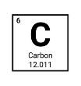
Carbon ?
Shorthand for CO₂ emissions
May also include CO₂ equivalents
  combined effect of all greenhouse gases
For cement (and concrete) we focus specifically on CO₂ emissions

Slide 9
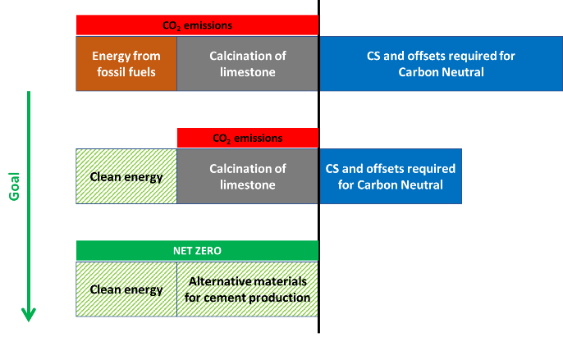
Carbon Neutrality in Cement
Carbon Neutral
  A neutral effect of CO₂ on the atmosphere
Net Zero
  Releases a net of zero CO₂ into the atmosphere

Slide 10
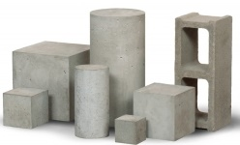
Spread the word, it matters:
Concrete and cement are not the same
Cement
Concrete (and masonry, grout, etc.)

Slide 11
What about a concrete building?
What do we measure?
GWP or cement limits
Cradle-to-gate concrete
Cradle-to-grave concrete
Building Life Cycle
Includes heating, cooling, etc.
Goal

Slide 12
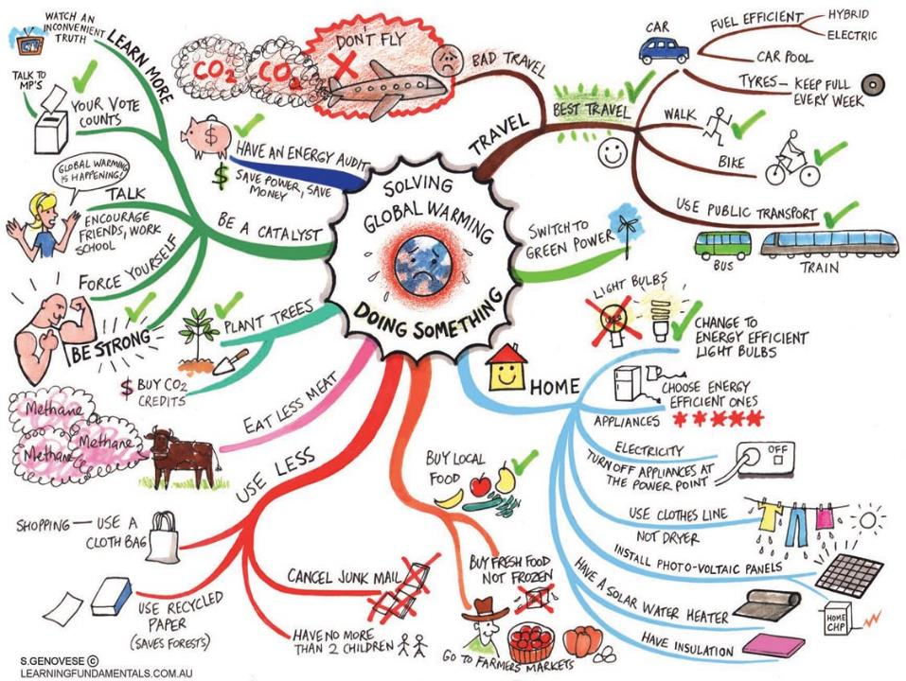

Slide 13
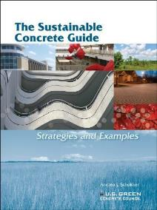
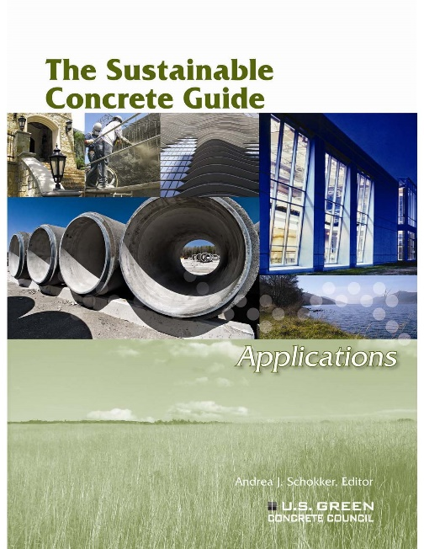
What can we do?
The Sustainable Concrete Guide:
Carbon Neutral Materials and Technologies

Slide 14

Concrete as a Material:
A sample of ways to lower carbon emissions
Reduction of cement manufacturing energy
Pozzolans
Alternative cements
Cement from a different base material/process
Carbon capture & sequestration

Slide 15
Sustainable Concrete Overview
Sustainability and Resiliency
Natural resources
Benefits of concrete as a building material

Slide 16
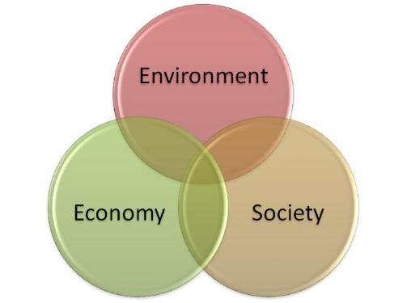
Sustainable
Green
Eco-friendly
“…meeting the needs of the present without compromising the ability of future generations to meet their own needs.”
Brundtland Commission, United Nations, 1987
Life cycle cost

Slide 17
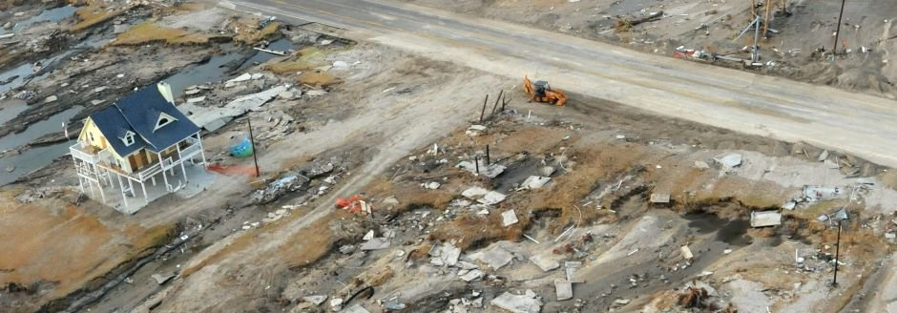
Resilient
an ability to recover from or adjust easily to adversity or change

Slide 18
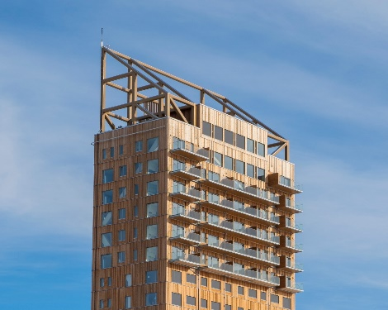
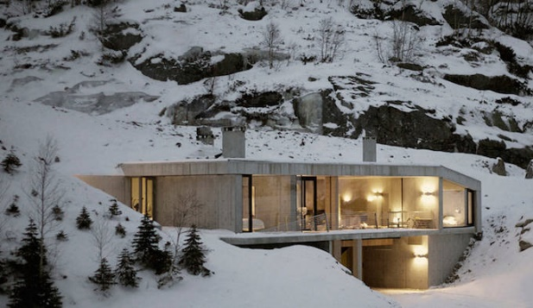
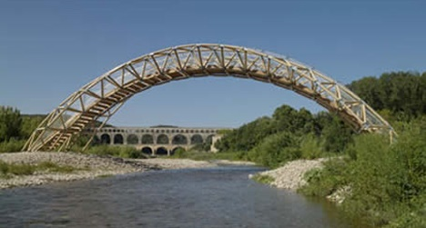
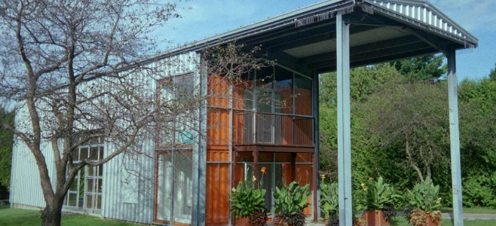
Are Sustainability and Resiliency the same?
More
Sustainable
Less
Sustainable
Recycled paper bridge
Less Resilient
More Resilient

Slide 19



Depletion of Natural Resources
Reduce
  Minimize waste through reduction of resource use
Reuse
  Using again in basically the same form
Recycle
  Breaking down the material into components to form a new component or use
New construction
Least use of resources
Least CO₂ emissions
Most use of resources
Most CO₂ emissions

Slide 20
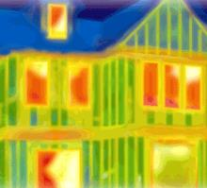
Energy Use
Embodied
Operational
  Building enclosure
    Thermal resistance
    Avoiding thermal bridges
  Efficient fixtures, appliances, and practices by users
  Renewable energy
  Incorporation of passive effects
    Thermal mass
    Passive solar

Slide 21
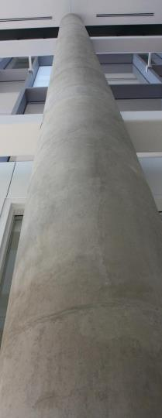
Thermal Mass
High heat capacity + low thermal diffusivity = good thermal mass potential
Heat capacity
  The property of a body to store heat
Thermal diffusivity
  Slow transfer of heat
Concrete
Good heat capacity, relatively low thermal diffusivity + HIGH MASS
  Reduces temperature spikes
  Delays temperature effects
  Effective with passive solar
  REDUCED ENERGY DEMAND

Slide 22
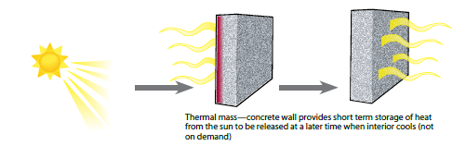
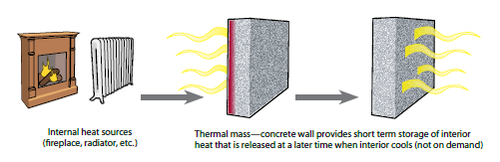
Thermal Mass
External
Source
Internal
Source

Slide 23
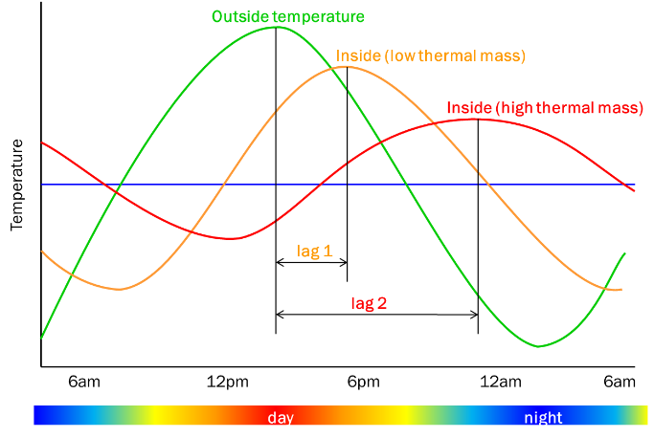
Temperature Lag

Slide 24
Hot/Dry Climate
  High potential for energy savings
  Thermal mass in building envelope retards high flow in during the day and radiates heat back out during the night
  Use with good ventilation to exchange inside air at night with cool outside air
Cold Climate
  Medium potential for energy savings
  Follow passive solar strategies:
    good envelope insulation
    Interior surfaces (walls/framing and floors) with thermal mass exposed to direct sunlight
Hot/Humid Climate
  Lower overall potential for energy savings
  Good insulation and thermal mass in the envelope will level out temperature spikes outside and minimize the HVAC load inside

Slide 25
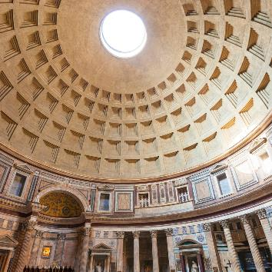
Other factors
Acoustics
Daylighting
Air Quality
Heat island effect
Aesthetics
Pantheon, circa 126 A.D.

Slide 26
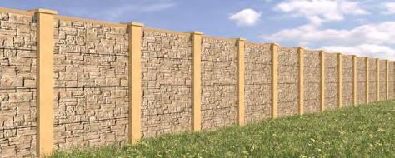
Acoustics
Sound quality
Noise reduction
  Transmitted noise
    Use high mass materials
  Reflected noise
    Use absorbing, textured materials
MnDOT

Slide 27
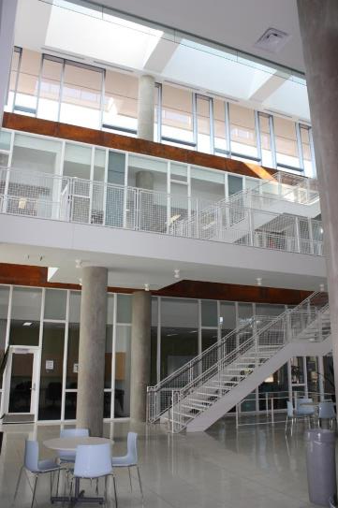
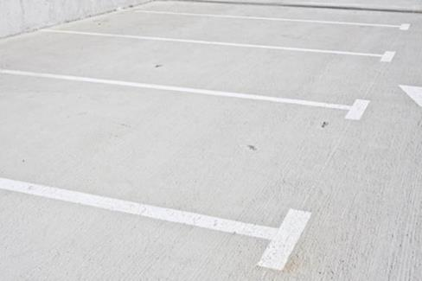
Daylighting (Interior)
Heat Island (Exterior)

Slide 28
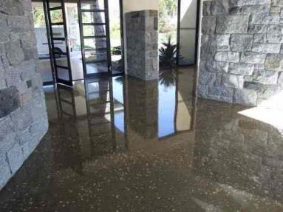
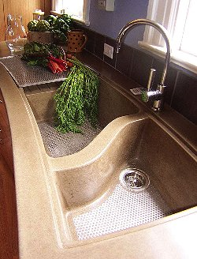
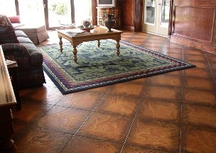
Air Quality & Natural Finishes

Slide 29


What is on the way?
Legislation with Global Warming Potential limits tracking to zero with time
Large scale implementation of current sustainable practices
Owners targeting carbon neutrality goals
Significant innovations in materials and processes

Slide 30



Thank you!
www.neuconcrete.org
info@neuconcrete.org
NEU: An ACI Center of Excellence for Carbon Neutral Concrete
@NEUCarbonNeutralConcrete
@NEUconcrete

